Slide 1
String in Java
What is String
2. Immutable String
3. Commonly used method
4. String buffer
5. String builder
6. String vs String Buffer
7. String buffer vs String builder
8. Immutable class

Slide 2
1. What is String
String is basically an object that represents sequence of characters.
String class is used to create a string object.
String class implements Serializable, Comparable and CharSequence interfaces.
CharSequence interface is used to represent the sequence of characters. String, StringBuffer, StringBuilder classes implement it.
There are two ways to create String object:
- By string literal ( example : String s = "welcome"; )
- By new keyword : khởi tạo và lưu trữ đối tượng ở những vị trí khác nhau trong bộ nhớ.
( example : String s = new String("Welcome"); )

Slide 3

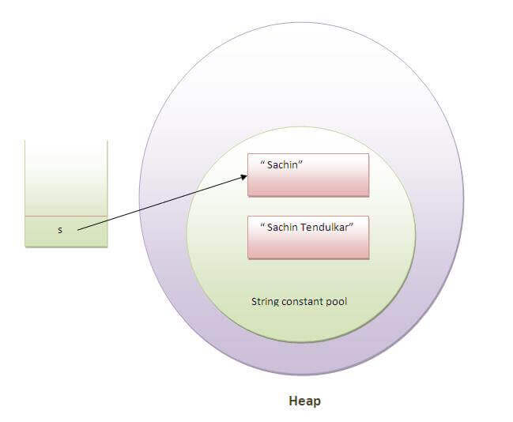

2.Immutable String
String objects are immutable. Immutable simply means unmodifiable or unchangeable.
- Example :
- But if we explicitly assign it to the reference variable:

Slide 4
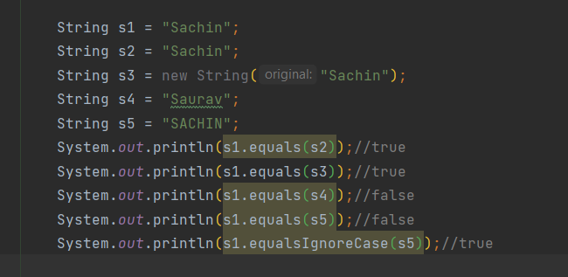
3. Commonly used method
3.1 Compare
*Used equals() method :
- The String equals() method compares the original content of the string. It compares values of string for equality. String class provides two methods:
public boolean equals(Object another) compares this string to the specified object.
public boolean equalsIgnoreCase(String another) compares this String to another string, ignoring case.
Example:

Slide 5
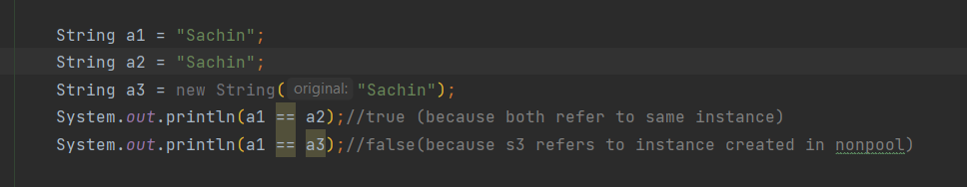
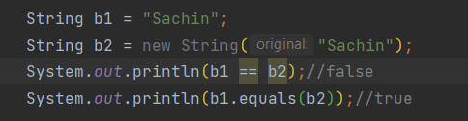
*String compare by == operator
*The difference between equals() and '=='
- equals() : compare the values of the object (compare the contents).
(so sánh các giá trị của đối tượng (so sánh nội dung)).
- '==': check if 2 objects point to the same memory area (address comparison).
(kiểm tra xem 2 đối tượng có cùng trỏ đến 1 vùng nhớ hay không (so sánh địa chỉ)).

Slide 6
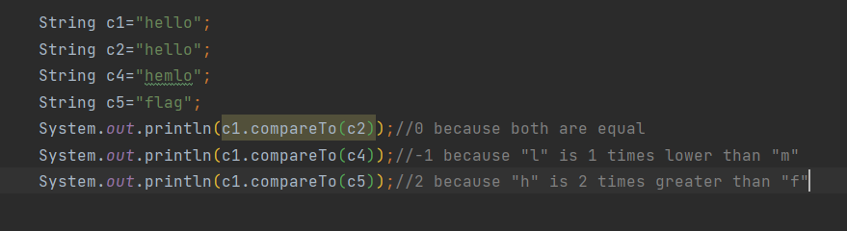
*Used compareTo() method
- The java string compareTo() method compares the given string with current string lexicographically. It returns positive number, negative number or 0.
if s1 > s2, it returns positive number
if s1 < s2, it returns negative number
if s1 == s2, it returns 0

Slide 7


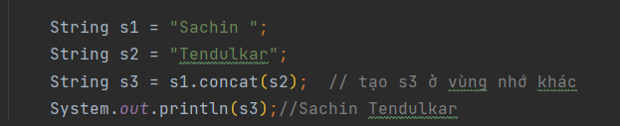
3.2 Concatenation : String concatenation forms a new string that is the combination of multiple strings.
- String concatenation forms a new string that is the combination of multiple strings.
*User operator + :
As
- Note: After a string literal, all the + will be treated as string concatenation operator.
*User concat() method:

Slide 8


3.3 Substring: substring is a subset of another string
- substring(int startIndex)
- substring(int startIndex, int endIndex)

Slide 9
3.4 toString() method
Represent any object as a string
Overriding the toString() method, returns the desired output, it can be the state of an object etc. depends on your implementation.

Slide 10

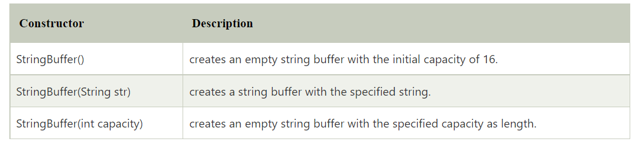
4. String Buffer (synchronized )
Java StringBuffer class is used to create mutable (modifiable) string.
Important Constructors of StringBuffer class

Slide 11
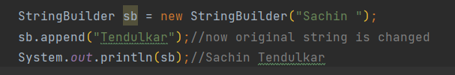
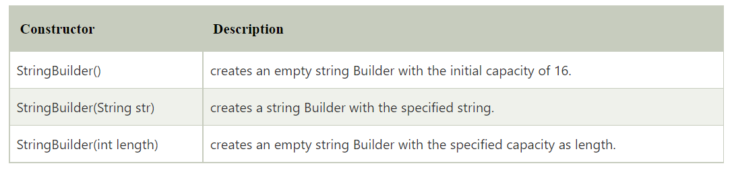
5. String Builder(non-synchronized )
Java StringBuilder class is used to create mutable (modifiable) string.
The Java StringBuilder class is same as StringBuffer class except that it is non-synchronized.
It is available since JDK 1.5.
Important Constructors of StringBuilder class

Slide 12
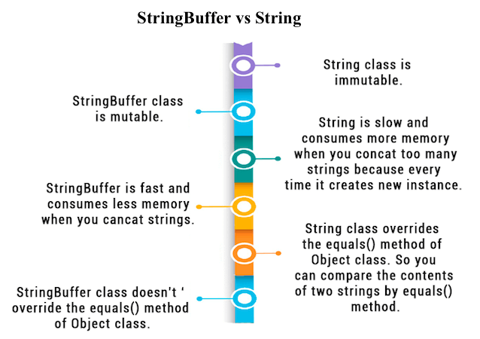
6. String vs String Buffer
Note: String buffer used toString() instead of equals()

Slide 13
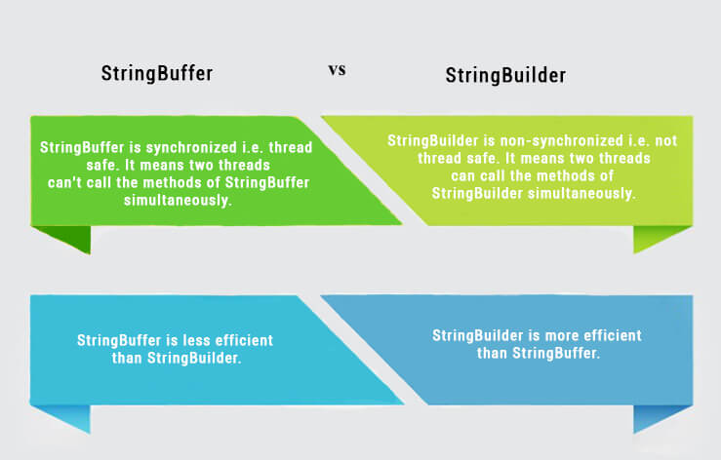
7. String Builder vs String Buffer

Slide 14
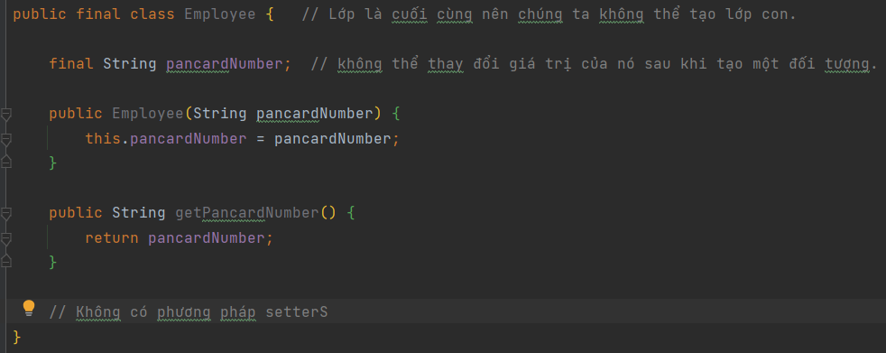
8. Immutable class
Characteristics of the immutable class :
- The instance variable of the class is final.
- The class is final so cannot create the subclass.
- There is no setter methods

Slide 15
9. String Tokenizer class
The java.util.StringTokenizer class allows you to break a string into tokens.
See details at : https://viettuts.vn/java-string/string-tokenizer-trong-java

